Slide 1
IT 356: Introduction To Computer Graphics (Lecture 07)
School of Information Technology
Illinois State University
Dr. Qi Zhang, Spring 2024

Slide 2
Exp01_lec07

Slide 3
Set Up Vertex Data
Set up vertex data in texture space:
float vertices[] = {
-0.5f, -0.5f, 0.0f, //left
0.5f, -0.5f, 0.0f, //right
0.0f, 0.5f, 0.0f //top
};

Slide 4
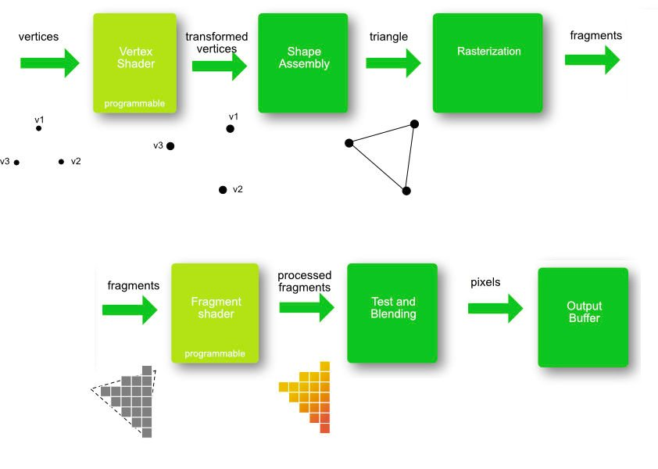
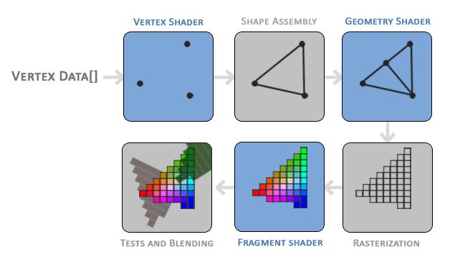
Vertex Shader
With the vertex data defined, we'd like to send it as input to the first graphics pipeline process: the vertex shader.
This is done by creating memory on the GPU where we store the vertex data, configuring how OpenGL should interpret the memory, and specifying how to send the data to the graphics card.
The vertex shader then processes as many vertices as we tell it to from its memory.

Slide 5
Vertex Buffer Object
We manage this memory via so-called vertex buffer objects (VBO) that can store a large number of vertices in the GPU's memory.
The advantage of using those buffer objects is that we can send large batches of data all at once to the graphics card and keep it there if there's enough memory left, without sending data one vertex at a time.
Sending data to the graphics card from the CPU is relatively slow, so wherever we can, we try to send as much data as possible at once. Once the data is in the graphics card's memory, the vertex shader has almost instant access to the vertices, making it extremely fast.
//Vertex Buffer Object (VBO)
unsigned int VBO;

Slide 6
Vertex Buffer Object
Just like any object in OpenGL, a vertex buffer object (VBO) has a unique ID corresponding to that buffer, so we can generate one with a buffer ID using the glGenBuffers function.
glGenBuffers(1, &VBO);

Slide 7
GL_ARRAY_BUFFER
OpenGL has many types of buffer objects, and the buffer type of a vertex buffer object is GL_ARRAY_BUFFER.
OpenGL allows us to bind to several buffers simultaneously if they have a different buffer type.
We can bind the newly created buffer to the GL_ARRAY_BUFFER target with the glBindBuffer function:
glBindBuffer(GL_ARRAY_BUFFER, VBO);
From then on, any buffer calls we make (on the GL_ARRAY_BUFFER target) will configure the currently bound buffer, VBO. Then, we can make a call to the glBufferData function that copies the previously defined vertex data into the buffer's memory:
glBufferData(GL_ARRAY_BUFFER, sizeof(vertices), vertices, GL_STATIC_DRAW);

Slide 8
GL_ARRAY_BUFFER
glBufferData is a function specifically targeted to copy user-defined data into the currently bound buffer.
Its first parameter is the type of buffer we want to copy data into the vertex buffer object currently bound to the GL_ARRAY_BUFFER target.
The second parameter specifies the data size (in bytes) we want to pass to the buffer; a simple sizeof of the vertex data.
The third parameter is the actual data we want to send.
The fourth parameter specifies how we want the graphics card to manage the given data. This can take three forms:
GL_STREAM_DRAW: the data is set only once and used by the GPU at most a few times.
GL_STATIC_DRAW: the data is set only once and used many times.
GL_DYNAMIC_DRAW: the data is changed a lot and used many times.

Slide 9
Vertex Data Within Memory
As of now we stored the vertex data within memory on the graphics card as managed by a vertex buffer object named VBO.
Next, we want to create a vertex and fragment shader that actually processes this data

Slide 10
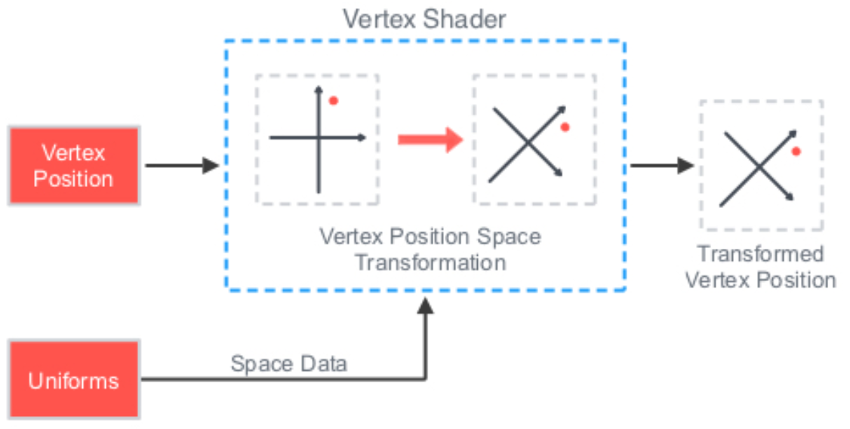
Vertex Shader
The vertex shader is one of the shaders that are programmable
Modern OpenGL requires that we at least set up a vertex and fragment shader if we want to do some rendering, so we will briefly introduce shaders and configure two very simple shaders for drawing the first triangle.

Slide 11
Vertex Shader
The first thing we need to do is write the vertex shader in the shader language GLSL (OpenGL Shading Language) and then compile this shader so we can use it in our application.
Below, you'll find the source code of a very basic vertex shader in GLSL:
#version 460 core
layout (location = 0) in vec3 aPos;
void main()
{
gl_Position = vec4(aPos.x, aPos.y, aPos.z, 1.0);
}
As you can see, GLSL looks similar to C. Each shader begins with a declaration of its version.
GLSL version 460 corresponds to OpenGL version 4.6
We also explicitly mention that we're using core profile functionality.

Slide 12
Vertex Shader
Right now, we only care about position data, so we only need a single vertex attribute.
GLSL has a vector datatype that contains 1 to 4 floats based on its postfix digit. Since each vertex has a 3D coordinate, we create a vec3 input variable with the name aPos. We also specifically set the location of the input variable via layout (location = 0).
#version 460 core
layout (location = 0) in vec3 aPos;
void main()
{
gl_Position = vec4(aPos.x, aPos.y, aPos.z, 1.0);
}

Slide 13
Vector
In graphics programming, we use the mathematical concept of a vector
Vector represents positions/directions in any space and has useful mathematical properties.
A vector in GLSL has a maximum size of 4, and each of its values can be retrieved via vec.x, vec.y, vec.z, and vec.w, respectively, where each of them represents a coordinate in space.
The vec.w component is not used as a position in space but for something called perspective division.

Slide 14
The Output of the Vertex Shader
To set the output of the vertex shader, we have to assign the position data to the predefined gl_Position variable, which is a vec4 behind the scenes.
At the end of the main function, whatever we set gl_Position will be used as the output of the vertex shader.
Since our input is a vector of size 3, we have to cast this to a vector of size 4.
We can do this by inserting the vec3 values inside the constructor of vec4 and set its w component to 1.0f.
#version 460 core
layout (location = 0) in vec3 aPos;
void main()
{
gl_Position = vec4(aPos.x, aPos.y, aPos.z, 1.0);
}

Slide 15
The Output of the Vertex Shader
The current vertex shader is the simplest vertex shader because we did no processing on the input data and simply forwarded it to the shader's output.
In real applications, the input data is usually not already in normalized device coordinates, so we must first transform the input data to coordinates within OpenGL's visible region.

Slide 16
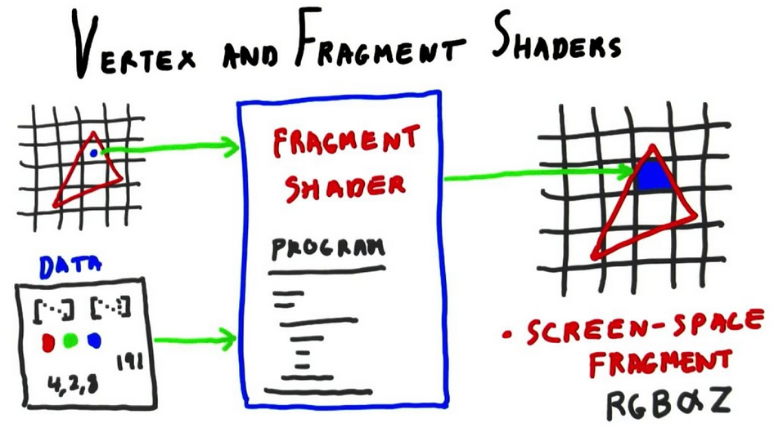
Fragment shader
The fragment shader is the second and final shader we will create for rendering a triangle.
The fragment shader is all about calculating the color output of your pixels. To keep things simple, the fragment shader will always output a red color
#version 460 core
out vec4 FragColor;
void main()
{
FragColor = vec4(1.0f, 0.0f, 0.0f, 1.0f);
}

Slide 17
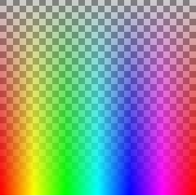
Colors in Computer Graphics
Colors in computer graphics are represented as an array of 4 values: the red, green, blue, and alpha (opacity) component, commonly abbreviated to RGBA.
When defining a color in OpenGL or GLSL, we set the strength of each component to a value between 0.0 and 1.0. If, for example, we would set red to 1.0 and green to 1.0, we would get a mixture of both colors and get the color yellow.
Given those three-color components, we can generate over 16 million colors!
RGBA color model
https://en.wikipedia.org/wiki/RGBA_color_model

Slide 18
Fragment Shader Output
The fragment shader only requires one output variable, a vector of size four that defines the final color output we should calculate ourselves.
We can declare output values with the out keyword, which we here promptly named FragColor.
Next, we assign a vec4 to the color output as a red color with an alpha value of 1.0 (1.0 being completely opaque).
#version 460 core
out vec4 FragColor;
void main()
{
FragColor = vec4(1.0f, 0.0f, 0.0f, 1.0f);
}

Slide 19
Compiling a Shader
We take the source code for the vertex shader and store it in a const C string.
For OpenGL to use the shader, it must dynamically compile it at run-time from its source code.

Slide 20
Compiling a Shader
The first thing we need to do is create a shader object, again referenced by an ID.
So, we store the vertex shader as an unsigned int and create the shader with glCreateShader:
// Declare Vertex shader referenced by an ID
unsigned int vertexShader;
// Create the shader with glCreateShader
vertexShader = glCreateShader(GL_VERTEX_SHADER);
We provide the type of shader we want to create as an argument to glCreateShader. Since we're creating a vertex shader, we pass in GL_VERTEX_SHADER.

Slide 21
Attach the Shader Source Code
Next, we attach the shader source code to the shader object and compile the shader:
// We attach the shader source code to the shader object and compile the shader
glShaderSource(vertexShader, 1, &vertexShaderSource, NULL);
glCompileShader(vertexShader);
The glShaderSource function takes the shader object to compile to as its first argument.
The second argument specifies how many strings we're passing as source code, which is only one.
The third parameter is the actual source code of the vertex shader, and we can leave the 4th parameter to NULL.

Slide 22
Check Compiling Result
Check if compilation was successful after the call to glCompileShader and if not, what errors were found so you can fix those.
//Check for shader compile errors
int success;
char infoLog[512];
glGetShaderiv(vertexShader, GL_COMPILE_STATUS, &success);
We define an integer to indicate success and a storage container for the error messages (if any). Then we check if the compilation was successful with glGetShaderiv.
If compilation failed, we should retrieve the error message with glGetShaderInfoLog and print the error message.
If no errors were detected while compiling the vertex shader it is now compiled.
if (!success)
{
glGetShaderInfoLog(vertexShader, 512, NULL, infoLog);
std::cout << "ERROR::SHADER::VERTEX::COMPILATION_FAILED\n" << infoLog << std::endl;
}

Slide 23
Compile Fragment Shader
The process for compiling a fragment shader is similar to the vertex shader; this time, we use the GL_FRAGMENT_SHADER constant as the shader type:
// Compile fragment shader
unsigned int fragmentShader;
fragmentShader = glCreateShader(GL_FRAGMENT_SHADER);
glShaderSource(fragmentShader, 1, &fragmentShaderSource, NULL);
glCompileShader(fragmentShader);
Both the shaders are now compiled
The only thing left to do is link both shader objects into a shader program we can use for rendering.

Slide 24
Check Compiling Errors
Check for compile errors
//Check for shader compile errors
glGetShaderiv(fragmentShader, GL_COMPILE_STATUS, &success);
if (!success)
{
glGetShaderInfoLog(fragmentShader, 512, NULL, infoLog);
std::cout << "ERROR::SHADER::FRAGMENT::COMPILATION_FAILED\n" << infoLog << std::endl;
}

Slide 25
Link Shader Objects
Both the shaders are now compiled
The only thing left to do is link both shader objects into a shader program we can use for rendering.

Slide 26
Shader Program
A shader program object is the final linked version of multiple shaders combined.
To use the recently compiled shaders, we must link them to a shader program object and then activate this shader program when rendering objects.
The activated shader program's shaders will be used when we issue render calls.
Creating a program object:
//Link shaders
unsigned int shaderProgram;
shaderProgram = glCreateProgram();
The glCreateProgram function creates a program and returns the ID reference to the newly created program object.

Slide 27
Complied Shaders
We need to attach the previously compiled shaders to the program object and then link them with glLinkProgram:
// we need to attach the previously compiled shaders
// to the program object and then link them with glLinkProgram
glAttachShader(shaderProgram, vertexShader);
glAttachShader(shaderProgram, fragmentShader);
glLinkProgram(shaderProgram);
We attach the shaders to the program and link them via glLinkProgram.

Slide 28
Check Errors
Just like shader compilation, we can also check if linking a shader program failed and retrieve the corresponding log.
Instead of using glGetShaderiv and glGetShaderInfoLog, we now use:
//Check for linking errors
glGetProgramiv(shaderProgram, GL_LINK_STATUS, &success);
if (!success) {
glGetProgramInfoLog(shaderProgram, 512, NULL, infoLog);
std::cout << "ERROR::SHADER::PROGRAM::LINKING_FAILED\n" << infoLog << std::endl;
}

Slide 29
Delete the Shader Objects
Delete the shader objects once we've linked them to the program object.
We no longer need them anymore
glDeleteShader(vertexShader);
glDeleteShader(fragmentShader);

Slide 30
Return Shader Program
Return the ID of the created shader program from the function int loadShader(const char* vShaderFile, const char* fShaderFile)
return shaderProgram;

Slide 31
The Shader Program ID
// Declare the Shader Program (shaderProgram)'s ID
int programID;
// Initialize the shader program id with the created shaderProgram
programID = loadShader("../../src/shader/vshader_lec07_01.glsl", "../../src/shader/fshader_lec07_01.glsl");

Slide 32
Active Created Program Object
The result is a program object we can activate by calling glUseProgram with the newly created program object as its argument.
Every shader and rendering call after glUseProgram will now use this program object (and thus the shaders).
// Activate by calling glUseProgram with the newly created program object
// Use the shader program when we want to render an object
glUseProgram(programID);

Slide 33
Vertex Array Object
A vertex array object (also known as VAO) can be bound just like a vertex buffer object (VBO), and any subsequent vertex attribute calls from that point on will be stored inside the VAO.
This has the advantage that when configuring vertex attribute pointers, you only have to make those calls once, and whenever we want to draw the object, we can bind the corresponding VAO.
This makes switching between vertex data and attribute configurations as easy as binding a different VAO.
All the states we just set are stored inside the VAO.

Slide 34
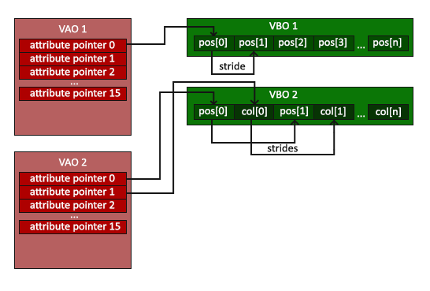
Vertex Array Object
Calls to glEnableVertexAttribArray or glDisableVertexAttribArray.
Vertex attribute configurations via glVertexAttribPointer.
Vertex buffer objects associated with vertex attributes by calls to glVertexAttribPointer.

Slide 35
Use Vertex Array Object
A VAO that stores our vertex attribute configuration and which VBO to use.
Usually, when you have multiple objects, you want to draw, you first generate/configure all the VAOs (and thus the required VBO and attribute pointers) and store those for later use.
The moment we want to draw one of our objects, we take the corresponding VAO, bind it, then draw the object and unbind the VAO again.

Slide 36
Draw An Object
Now that we have specified how OpenGL should interpret the vertex data, we should also enable the vertex attribute with glEnableVertexAttribArray, giving the vertex attribute location as its argument; vertex attributes are disabled by default.
From that point on, we have everything set up: we initialized the vertex data in a buffer using a vertex buffer object and set up a vertex and fragment shader.
We told OpenGL how to link the vertex data to the vertex shader's attributes.

Slide 37
Vertex Array Object
// Declare Vertex Array Object (VAO)
unsigned int VAO;
// Generate VAO
glGenVertexArrays(1, &VAO);
//As we only have a single VAO, there's no need to bind it every time,
//But we'll do so to keep things a bit more organized
glBindVertexArray(VAO);
To use a VAO, all you have to do is bind the VAO using glBindVertexArray.
From then on, we should bind/configure the corresponding VBO(s) and attribute pointer(s) and then unbind the VAO for later use.
As soon as we want to draw an object, we bind the VAO with the preferred settings before drawing the object.

Slide 38
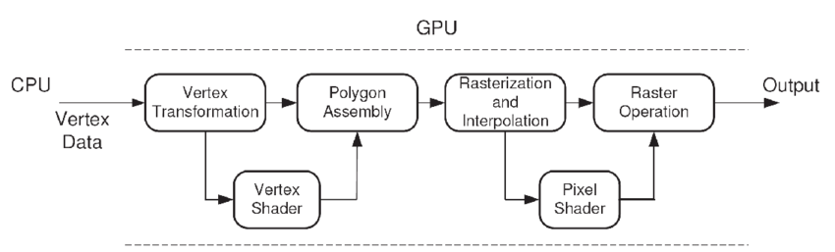
Interpret the Vertex Data
Right now, we sent the input vertex data to the GPU and instructed the GPU on how it should process the vertex data within a vertex and fragment shader.
OpenGL does not yet know how it should interpret the vertex data in memory and how it should connect the vertex data to the vertex shader's attributes.
We need to tell OpenGL how to do that.
fragment shader

Slide 39
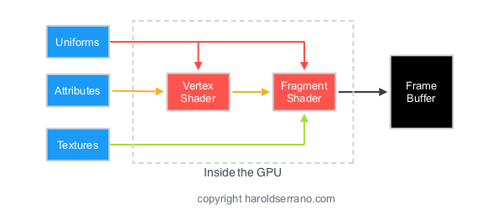
Linking Vertex Attributes
The vertex shader allows us to specify any input we want in the form of vertex attributes, and while this allows for great flexibility
We must manually specify what part of our input data goes to which vertex attribute in the vertex shader.
This means we have to specify how OpenGL should interpret the vertex data before rendering.
https://www.haroldserrano.com/blog/what-is-a-vertex-shader-in-opengl

Slide 40
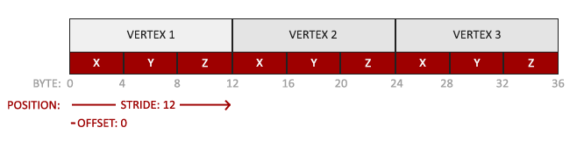
Format of Vertex Buffer Data
Our vertex buffer data is formatted as follows:
The position data is stored as 32-bit (4 byte) floating point values.
Each position is composed of 3 of those values.
There is no space (or other values) between each set of 3 values. The values are tightly packed in the array.
The first value in the data is at the beginning of the buffer.

Slide 41
Interpret the Vertex Data
We can tell OpenGL how it should interpret the vertex data (per vertex attribute) using glVertexAttribPointer
//Set the vertex attribute pointers
//Tell OpenGL how it should interpret the vertex data
glVertexAttribPointer(0, 3, GL_FLOAT, GL_FALSE, 3 * sizeof(float), (void*)0);
The first parameter specifies which vertex attribute we want to configure. Remember that we specified the location of the position vertex attribute in the vertex shader with layout (location = 0). This sets the location of the vertex attribute to 0 and since we want to pass data to this vertex attribute, we pass in 0.
The next argument specifies the size of the vertex attribute. The vertex attribute is a vec3, so it is composed of 3 values.
The third argument specifies the type of the data which is GL_FLOAT (a vec* in GLSL consists of floating-point values).

Slide 42
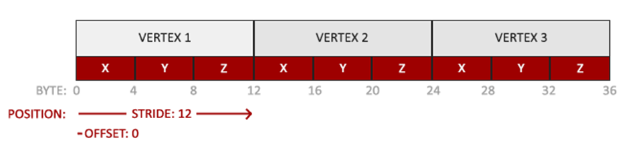
Interpret the Vertex Data
We can tell OpenGL how it should interpret the vertex data (per vertex attribute) using glVertexAttribPointer
//Set the vertex attribute pointers
//Tell OpenGL how it should interpret the vertex data
glVertexAttribPointer(0, 3, GL_FLOAT, GL_FALSE, 3 * sizeof(float), (void*)0);
The next argument specifies if we want the data to be normalized. If we input integer data types (int, byte) and set this to GL_TRUE, the integer data is normalized to 0 (or -1 for signed data) and 1 when converted to float. This is irrelevant to us, so we'll leave this at GL_FALSE.
The fifth argument is the stride and tells us the space between consecutive vertex attributes. Since the next set of position data is located exactly three times the size of a float away, we specify that value as the stride. Since we know the array is tightly packed (there is no space between the next vertex attribute value), we could've also specified the stride as 0 to let OpenGL determine the stride (this only works when values are tightly packed). Whenever we have more vertex attributes, we have to define the spacing between each vertex attribute carefully.
The last parameter is of type void* and thus requires that weird cast. This is the offset of where the position data begins in the buffer. Since the position data is at the start of the data array, this value is just 0.

Slide 43
Enable Vertex Attribute Array
Each vertex attribute takes its data from memory managed by a VBO and which VBO it takes its data from (you can have multiple VBOs) is determined by the VBO currently bound to GL_ARRAY_BUFFER when calling glVertexAttribPointer.
Since the previously defined VBO is still bound before calling glVertexAttribPointer, vertex attribute 0 is now associated with its vertex data.
// Enable vertex attribute array
glEnableVertexAttribArray(0);

Slide 44
Draw A Triangle
To draw our objects of choice, OpenGL provides the glDrawArrays function that draws primitives using the currently active shader, the previously defined vertex attribute configuration, and the VBO's vertex data (indirectly bound via the VAO).
//As we only have a single VAO, there's no need to bind it every time,
//But we'll do so to keep things a bit more organized
glBindVertexArray(VAO);
//Draw our first triangle
glDrawArrays(GL_TRIANGLES, 0, 3);
//No need to unbind it every time
glBindVertexArray(0);

Slide 45
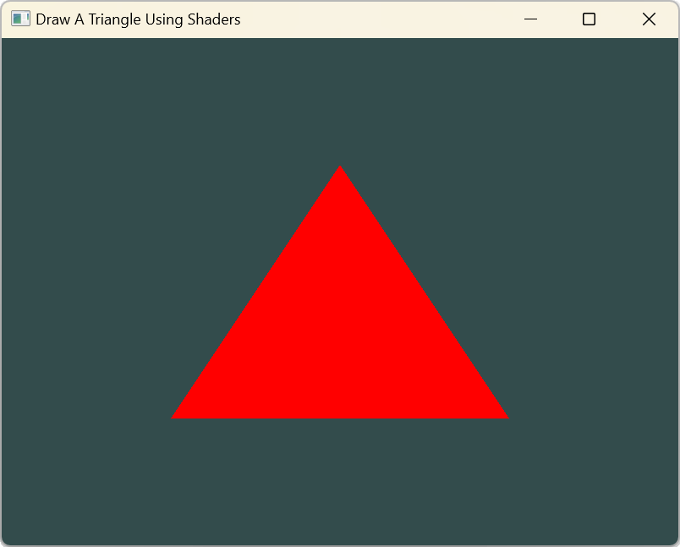
Draw A Triangle
The glDrawArrays function takes as its first argument the OpenGL primitive type we would like to draw. To draw a triangle, pass in GL_TRIANGLES.
The second argument specifies the starting index of the vertex array we'd like to draw; leave this at 0. The last argument specifies how many vertices we want to draw, which is 3.
//Draw our first triangle
glDrawArrays(GL_TRIANGLES, 0, 3);

Slide 46
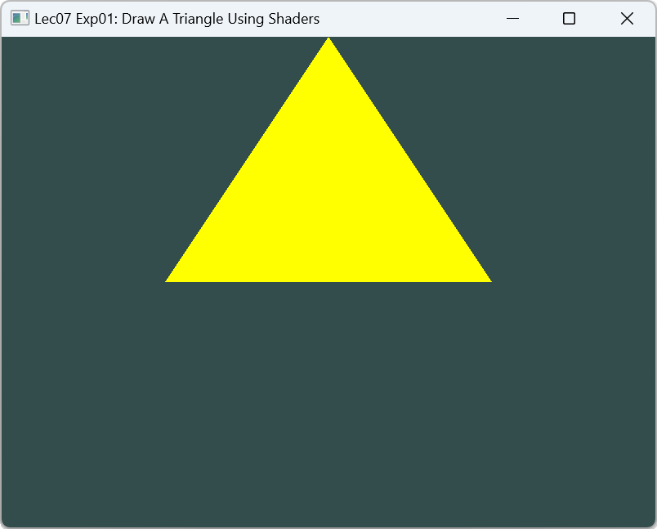
Exercise
Change the triangle color to yellow by updating fragment shader
Shift the triangle 0.5 up by updating the vertex shader vshader_lec07_01.glsl

